Slide 1
Introduction to Web and Distributed Programming

Slide 2
Objectives
Define what is distributed computing and understand the associated opportunities and challenges that are involved
Explore the workings of the Internet and the World Wide Web
Understand the security problems involved in Web applications
Outline key technologies in web programming

Slide 3
Overview of Distributed Systems

Slide 4
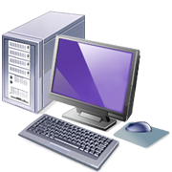
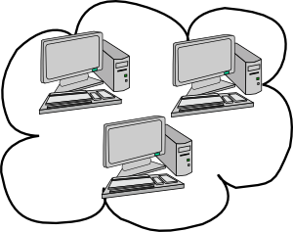
Why Distributed/Web Computing?
World is filled with computing machines
Why not choose a single machine?
Data separation: need to communicate
Performance/Scaling: single machine not fast enough
Cost-effectiveness: increasing processing power of single machine is hard and expensive
Reliability: single machine means single point of failure

Slide 5
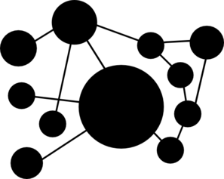
Distributed System Definition
A distributed computing system is an
Autonomous set of nodes
Linked together by a computer network
Communicating by passing messages

Slide 6
Properties of Distributed Systems
Major properties of distributed systems:
Unknown structure:
How many machines?
Connectivity (network topology)
Each node has a limited view of data
Fault-tolerant

Slide 7
Distributed Systems Examples
Some examples:
Internet – World Wide Web
Cloud computing platforms (Microsoft Azure, Amazon Web Services, etc.)
Computing clusters for scientific applications
Telematics based agricultural applications (JDLink)

Slide 8
Issues in Distributed Systems
Distributed computing introduces additional complications/issues:
Heterogeneity
different types of hardware, software, protocols
Openness
every service should be equally accessible to every client
Communication
latency
synchronization

Slide 9
Issues in Distributed Systems
Partial Failures
need to maintain availability and be fault-tolerant
Security
confidentiality, integrity, availability, nonrepudiation
Scalability
need to possibly support large number of nodes
Transparency
system should appear to be a single system
Notes:
Also Legalities, Privacy, and Data Ownership can be a challenge

Slide 10
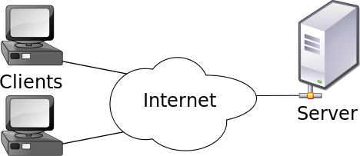
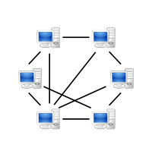
Communication Architectures
Client / Server
One machine (the server) is a distinguished node
All other machines (the clients) communicate with the server
Peer-to-Peer
All machines can act as both client and server

Slide 11
The Internet

Slide 12

The Internet (History)
The Internet has roots in a Department of Defense project
Needed a robust network that will withstand attacks
Led to creation of ARPAnet (1960s)
First node: UCLA – 1969
Led to other projects:
BITnet, Csnet (1970s, 1980s): email, file transfer

Slide 13
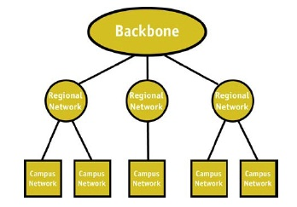
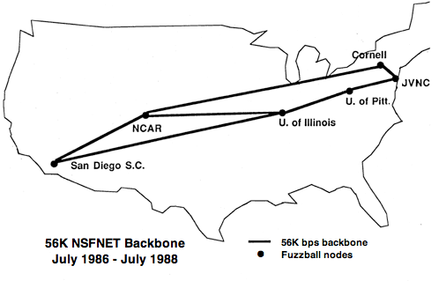
The Internet (History cont.)
Later, led to NSFnet (1986)
Originally connected 5 supercomputer centers
Used a three-tiered network architecture
1990 – replaced ARPAnet for non-military uses
Became available for all to use
Eventually became the known as the Internet

Slide 14
The Internet
The Internet is a network of networks
Based on the idea of packet switching:
Data is divided into packets
Packets are uniquely numbered in sequence
Destination address is included in every packet
Each packet may take a different route from source to destination (decided by routers)
Packets are reassembled using sequence numbers

Slide 15
Packet Switching Example

Slide 16
Packet Switching
Advantages of packet switching:
No centralized control (robust): can reroute around failed nodes
Efficient: packets can be routed along most efficient path
Lower cost compared to dedicated lines (circuits)

Slide 17
Internet Protocols
Mechanism for implementing the Internet:
TCP/IP protocol(s)
Protocol: set of rules
TCP/IP Protocols
4 layers: application, transport, internet, and link
Each layer hides the implementation of the bottom layer

Slide 18
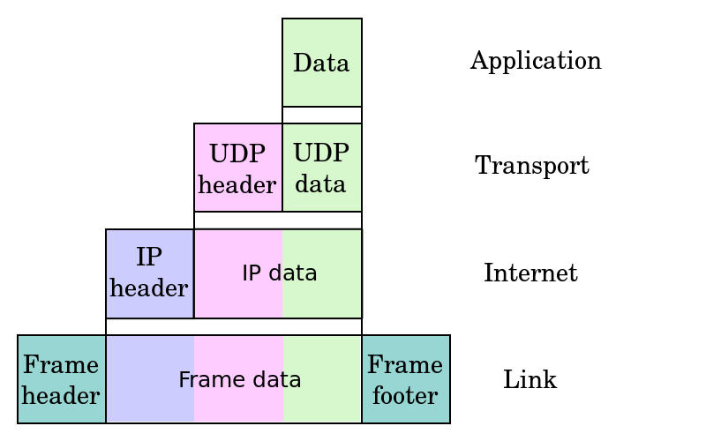
TCP/IP
Application Layer Protocols - Top Layer
Describes format of data for specific applications
HTTP (WWW), Telnet, email, FTP (file transfer)
Transport Layer Protocols
Describe how data is sent from end-to-end
Handles connections, flow control, congestion
TCP, UDP
Internet Layer Protocols
Provides an addressing scheme
Implements routing algorithms for transporting data to destination address
IPv4, IPv6
Link Layer Protocols - Bottom Layer
How two machines are physically connected
Wired (Ethernet), Wireless (WiFi), PPP, Fiber

Slide 19
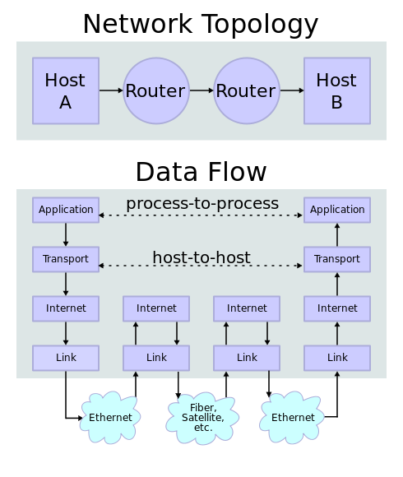
TCP/IP - Example

Slide 20
Internet - Addressing
Packets need to know their destination
In the Internet, each node has a designated (IP) address
Internet Protocol (IP) Addressing
Each node has a unique address (number)
IPv4: 32-bit binary number, IPv6: 128-bit
e.g. 157.23.43.101
Organizations are assigned a group of IPs

Slide 21
Domain Names*
IP addresses (numbers) are difficult to remember
Solution: Domain Name System (DNS)
Servers that look-up a number given an easier to remember name
provides functionality similar to a phone book
converts fully qualified domain names to IP addresses
Fully qualified domain name: host name and all of the domain names
Form: host-name.domain-names
First domain is the smallest; last is the largest
Last domain specifies the type of organization
Example: cs.lewisu.edu
Notes:
Share Bob Parsons DNS / GoDaddy learning moment.

Slide 22
Domain Names
The last part of a domain name, called a top-level domain (TLD), indicates the type of organization:
Suffix | Organization Type/Country
edu | Educational institution
com | Commercial entity
org | Non-profit organization
net | Network-based organization
uk | United Kingdom
au | Australia
ca | Canada

Slide 23
The World Wide Web

Slide 24
The World Wide Web
Origins
Tim Berners-Lee at CERN proposed the Web in 1989
Purpose: to allow scientists to have access to many databases of scientific work through their own computers
The World Wide Web is a system of interlinked hypertext documents accessed via the Internet
Collection of servers
Client/server architecture
WWW is not the same as the Internet

Slide 25
Web Browsers
A browser is a program which accesses and presents information
text, graphics, video, sound, audio, executable programs
Mosaic - NCSA (Univ. of Illinois), in early 1993
First to use a GUI, led to explosion of Web use
Initially for X-Windows, under UNIX, but was ported to other platforms by late 1993
Browsers request documents from Web Servers

Slide 26
Web Browsers (cont.)
Browsers are clients - always initiate,
Servers react
(although sometimes servers require responses)
Most requests are for existing documents, using HyperText Transfer Protocol (HTTP)
(but some requests are for program execution, with the output being returned as a document)

Slide 27
Web Servers
Web servers provide responses to browser requests
Either existing documents or dynamically built documents
Browser-server connection is now maintained through more than one request-response cycle

Slide 28
Web Servers (continued)
Communications between browsers and servers use HTTP
Web servers run as background processes in the operating system
Monitor a communications port on the host, accepting HTTP messages when they appear
Web servers have two main directories:
Document root (servable documents)
Server root (server system software)
Document root is accessed indirectly by clients
Its actual location is set by the server configuration file
Requests are mapped to the actual location

Slide 29
Common Web Servers
Apache (open source, fast, reliable)
Currently the most popular web server
Open source
Cross-platform: UNIX, Linux, Mac OS X, Windows, etc.
Installed on the computer science web server
Maintained by editing its configuration file
IIS (Microsoft)
Maintained through a program with a GUI interface

Slide 30
URLs
Web addresses are URL - Uniform Resource Locator
A server address and a path to a particular file
Example: http://www.lewisu.edu/academics/colleges.htm
Web servers return the specified file
If no file is specified, web server looks for default filename -usually index.html

Slide 31
The HyperText Transfer Protocol
HTTP is the protocol used by ALL Web communications
Consists of two phases
Request Phase
Response Phase
Each communication (request or response) has two parts
Header
Body

Slide 32
HTTP - Request Phase
Form:
HTTP method domain part of URL HTTP ver.
Header fields
blank line
Message body
An example of the first line of a request: GET /cs.uccp.edu/degrees.html HTTP/1.1
Most commonly used methods:
GET - Fetch a document
POST - Execute the document, using the data in body
HEAD - Fetch just the header of the document
PUT - Store a new document on the server
DELETE - Remove a document from the server

Slide 33
HTTP - Header Fields
Four categories of header fields
General
Request
Response
Entity
Common request fields:
Accept: text/plain
Accept: text/*
If-Modified_since: date
Common response fields:
Content-length: 488
Content-type: text/html

Slide 34
Multipurpose Internet Mail Extensions (MIME)
Within some fields of the form, there are specified types
e.g.:
Content-type: text/html
Accept: text/plain
These are examples of Multipurpose Internet Mail Extensions (MIME)
Originally developed for email
Used to specify to the browser the form of a file returned by the server (attached by the server to the beginning of the document)
Form: type/subtype
Examples: text/plain, text/html, image/gif, image/jpeg
Server gets type from the requested file name’s suffix
.html implies text/html
Browser gets the type explicitly from the server

Slide 35
HTTP - Response Phase
Form:
Status line
Response header fields
blank line
Response body
Status line format:
HTTP version status code explanation
Example: HTTP/1.1 200 OK (version is 1.1, status code is 200, explanation - “OK”)

Slide 36
Response Phase (cont.)
Status code is a three-digit number
First digit specifies the general status:
1 => Informational
2 => Success
3 => Redirection
4 => Client error
5 => Server error
The header field, Content-type, is required

Slide 37
Response Phase (cont.)
An example of a complete response header:
HTTP/1.1 200 OK
Date: Sat, 25 July 2009 20:15:11 GMT
Server: Apache /2.2.3 (CentOS)
Last-modified: Tues, 18 May 2004 16:38:38 GMT
Etag: "1b48098-16a-3dab592dc9f80"
Accept-ranges: bytes
Content-length: 364
Connection: close
Content-type: text/html, charset=UTF-8
Both request headers and response headers must be followed by a blank line

Slide 38
Communicate w/o Browser
Now, knowing how the HTTP protocol works, you can communicate with the web server without a browser
Just use the telnet tool (try it!):
> telnet www.lewisu.edu http
GET /index.html HTTP/1.1
Host: www.lewisu.edu
Connection: close

Slide 39
Security Issues

Slide 40
Security
There are many kinds of security problems with the Internet and the Web
One fundamental problem:
Getting data between a browser and a server without it being intercepted or corrupted in the process

Slide 41
Security
There are 4 general security problems for a communication between a browser and a server:
Confidentiality (privacy): message contents should not be visible to unwanted parties
Integrity: message contents should remain unchanged during transmission
Authentication: messages should be sent to the appropriate (i.e. authorized) party
Nonrepudiation: legally prove message was sent and received

Slide 42
Security
The basic tool to support privacy and integrity is encryption
Encryption: changing a message in such a way that only an authorized party can read it
Decrypting the message requires the knowledge of the cipher used and the key

Slide 43
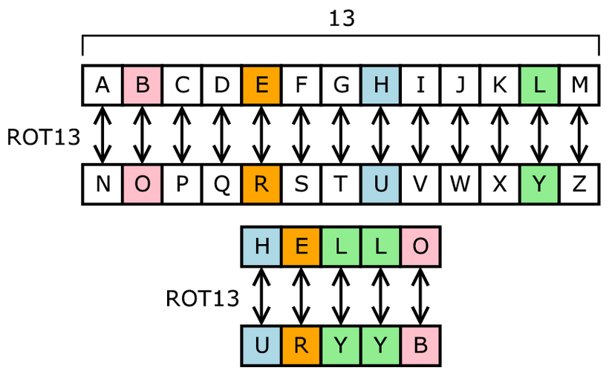
Security
Example of a simple cipher (called the Caesar cipher):
shift each letter by X positions in the alphabet
X is the key (e.g. 13)
Example of encrypting “HELLO”:

Slide 44
Security
Many encryption algorithms use symmetric-key ciphers: same key for encryption and decryption
Problem: If the sender and the receiver both use the same key, the key must be transmitted from the sender to the receiver
Solution: Public-key encryption
Use a public/private key pair
It works because it is virtually impossible to compute the private key from a given public key

Slide 45
Public-Key Encryption
Assume Bob wants to send a message to Alice
Alice uses a pair of keys (K_{E},K_{D}) and
makes key K_{E} public
keeps key K_{D} private
Anyone can use the public key K_{E} to encrypt a plaintext into a ciphertext sent to Alice
Only Alice can decrypt the ciphertext using the private key K_{D}
public key
private key
plaintext
encrypt
ciphertext
decrypt
plaintext

Slide 46
RSA Algorithm
The most popular encryption scheme is RSA, named after its inventors Rivest, Shamir, and Adleman (1978)
(The RSA patent expired in 2000)
The security of the RSA cryptosystem is based on the widely believed difficulty of factoring large numbers
The best known factoring algorithm (general number field sieve) takes time exponential in the number of bits of the number to be factored

Slide 47
Other security problems
Destruction of data on computers connected to the Internet
Viruses and worms
Other forms of malware
Denial-of-Service Attacks (DoS)
Created by flooding a Web server with requests
Even more powerful: Distributed DoS

Slide 48
Web Development Technologies

Slide 49
The Web Programmer’s Toolbox
Client Side
HTML
XML
JavaScript
Flash
Server Side
PHP
Ajax
Servlets and JavaServer Pages
ASP.NET
Ruby
Rails

Slide 50
HTML
HTML is used to describe the general form and layout of documents
An HTML document is a mix of content and controls
Controls are tags and their attributes
Tags often delimit content and specify something about how the content should be arranged in the document
Attributes provide additional information about the content of a tag
Tools for creating HTML documents
HTML editors - make document creation easier (Aptana Studio)
(shortcuts to typing tag names, spell-checker, etc.)
WYSIWYG HTML editors (Word)
(need not know HTML to create HTML documents)

Slide 51
XML
XML is a meta-markup language
XML is used to create a new markup language for a particular purpose or area
(since the tags are designed for a specific area, they can be meaningful)
No presentation details
A simple and universal way of representing and transmitting data of any textual kind

Slide 52
JavaScript
JavaScript is a client-side, HTML-embedded, scripting language
Provides a way to access elements of HTML documents and dynamically change them
Only related to Java through syntax
Dynamically typed and not object-oriented

Slide 53
Flash
Flash is a system for building and displaying text, graphics, sound, interactivity, and animation
Two parts:
Authoring environment
Player
Supports both motion and shape animation
Interactivity is supported with ActionScript
Obsolete!

Slide 54
PHP
PHP is a server-side scripting language
Similar to JavaScript, but designed to work on the web server
Great for form processing and database access through the Web

Slide 55
Ajax
Ajax is Asynchronous JavaScript + XML
No new technologies or languages
Much faster for Web applications that have extensive user/server interactions
Uses asynchronous requests to the server
Requests and receives small parts of documents, resulting in much faster responses

Slide 56
Java Web Software
Servlets – server-side Java classes
JavaServer Pages (JSP) – a Java-based approach to server-side scripting
An alternative to servlets
JavaServer Faces – adds an event-driven interface model on JSP

Slide 57
Active Server Pages
ASP does what JSP and JSF do
But in the .NET environment
Allows any .NET language to be used as a server-side scripting language
ASP.NET documents are compiled into classes

Slide 58
Ruby
Ruby is a pure object-oriented interpreted scripting language
Every data value is an object, and all operations are via method calls
Most operators can be redefined by the user
Both classes and objects are dynamic
Variables are all type-less references to objects

Slide 59
Rails
Rails is a development framework for Web-based applications
Particularly useful for Web applications that access databases
Written in Ruby and uses Ruby as its primary user language
Based on the Model-View-Controller architecture

Slide 60
Three-tier Architecture
So far we talked about client and server sides
However, modern web pages separate functionality among three tiers:
Client tier: Web browser
Business logic tier: Web server
Data/Information tier: Database
Examples of database systems:
MySQL
SQL Server

Slide 61
Summary
Distributed systems are used for performance, cost-effectiveness, reliability, and when data is separated
The Internet with the World Wide Web is the most famous distributed system
The Internet is based on the idea of packet switching and uses the TCP/IP protocol suite
The World Wide Web is based on the client/server architecture and uses the HTTP protocol
The four security issues (confidentiality, integrity, authentication, and nonrepudiation) can all be addressed using encryption
Common web development technologies include HTML, JavaScript (client side), PHP (server side), and MySQL (database)

